Slide 1
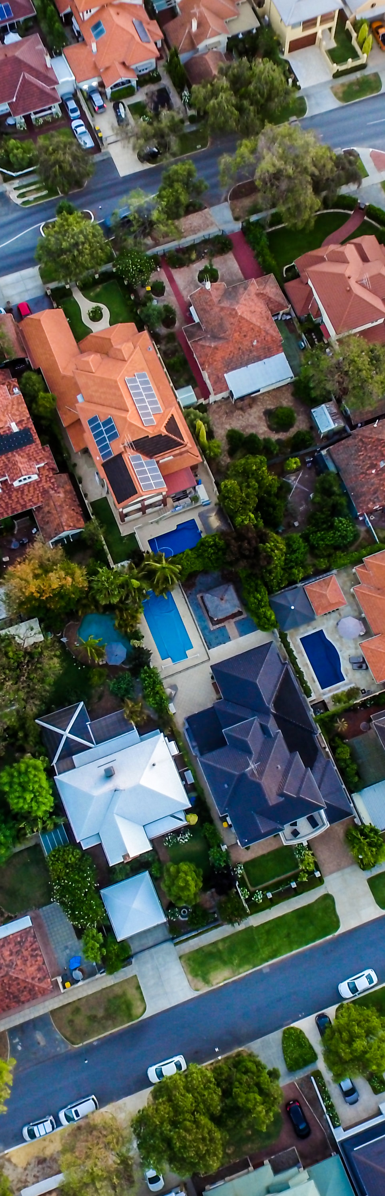
The factors that drive home prices
Notes:
Hello, and welcome. My name is Matthew Haworth, today I will be presenting my findings on the factors that drive home prices for the purposes of identifying profitable investment potential.

Slide 2
About the data
Sale Price
Mean | $ 180,921.20
Standard Error | $ 2,079.11
Median | $ 163,000.00
Mode | $ 140,000.00
Minimum | $ 34,900.00
Maximum | $ 755,000.00
For this analysis, the data set was a sample of 1460 houses in Ames, Iowa that were sold between 2006-2010.
There were 82 columns in the data set, with an approximately even distribution between categorical and numerical data.
This data originally comes from Kaggle: https://www.kaggle.com/alphaepsilon/housing-prices-dataset
Descriptive statistics from the dataset
Notes:
A few notes about the data set used for this analysis. The raw data makes heavy use of real estate specific terminology and abbreviations, if you have any questions regarding the verbiage, please don’t hesitate to ask and I will do my best to define it in place. I do have a couple leave behinds, namely the workbook containing my analysis, and raw data as well as my notes and a reference sheet that defines the abbreviations used and the data classification for each attribute.

Slide 3
Why does it matter?
Investors are essentially lending money to home buyers in the form of mortgage-backed securities, so the success of the process is dependent on the bank’s ability to identify profitable investments.
Important factors for investors to consider:
Valuation of property
Investment horizon
Profit opportunities
Notes:
My primary goal for this presentation is to identify unbiased factors that indicate that a property will be a good candidate for investment and creating a reproducible template that investors can utilize to classify which properties will most likely be profitable investments.

Slide 4
So, What affects home prices?
External factors like supply and demand and economic growth have an affect on home prices.
In addition, qualities of the home and property have a big impact on prices.
I hypothesized that some of the main driving factors would be:
Year built
Neighborhood
Square Footage
Quality
Condition
Notes:
I believe we all have an idealized version of a perfect home, but short of winning the lottery and building a house without regard to cost according to those ideals we are at the mercy of the market to provide options that fulfill our expectations within the means we have available.

Slide 5
Methodology
This project was done in Excel by utilizing pivot tables and the Data Analysis ToolPak to manipulate and visualize the data.
A/A test to determine if sample was biased
Find correlations between numerical variables and sale price
Using correlation results, picked the top correlated variables and ran multiple regression tests to further drill in and find variables with the most significance.
Ran regression, taking out insignificant variables until all p-values were <.05.
Ending r² = 0.79
Ran Student’s t-tests on resulting variables to check my work.
Notes:
I have analyzed what I believe to be an empirical and unbiased intersection of factors that appeal to prospective home buyers and satisfy requisite profit opportunities for investors.
(R² is a statistic that will give some information about the “goodness” of fit of a model. In regression, the R² coefficient of determination is a statistical measure of how well the regression predictions approximate the real data points. An R² of 1 indicates that the regression predictions perfectly fit the data.)
Student's t-test, in statistics, a method of testing hypotheses about the mean of a small sample drawn from a normally distributed population when the population standard deviation is unknown.

Slide 6
Methods Explained
Regression and correlation:
Note: Due to limitations of the dataset and tools used, it was deemed too labor intensive to consider every variable exhaustively, since converting categorical variables to numerical data for use in correlation and regression is inefficient in Excel.
Due to this, the correlation and regression process described was only carried out on existing numerical data.
T-tests:
Selected a number of categorical variables based on research and conducted Student’s T-tests to test the significance of their effects on home prices.
Notes:
While I did see several possible avenues to engineer numerical data from categorical data, I didn’t feel it necessary as there is a wealth of highly correlated factors in the existing numerical data.

Slide 7
The Results
From these methods, I distilled 10 of the top factors that drive home prices:
Top Factors that drive house prices
1. Overall Quality
2. Garage Cars
3. Fireplaces
4. Year Remodel added
5. Year Built
6. Above Ground Living SF
7. Masonry Veneer SF
8. Total Basement SF
9. Kitchen Quality
10. Neighborhoods
Today, we will review the top 5.
Notes:
Of the 40 some odd numerical factors considered, these are the top 10 that relate to sale price, for the purposes of this presentation we will be reviewing the top 5.

Slide 8
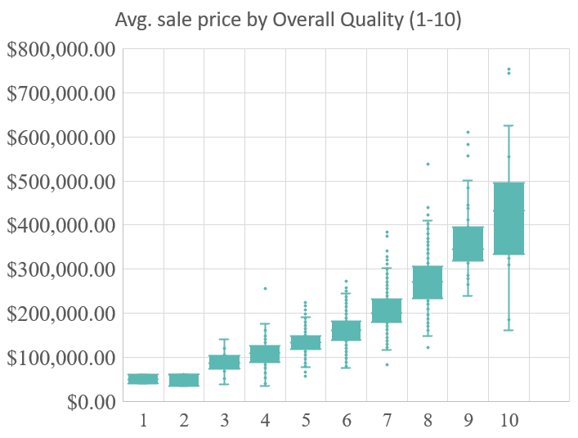
Top driving factor: Overall Quality
Correlation: 0.79
T-tests: H₀: p = 0, H₁: P < .05
Houses with quality score 10 vs. 9:
P = 0.087
Quality score 10 vs. 8:
P = 0.0004
P < .05 at .0004
Notes:
By far, the greatest factor driving home price was overall quality, an ordinal data type which rates the materials and finish of the house on a scale of 1 to 10, a score of 1 being very poor and a score of 10 being very excellent. In a home with an overall quality score of 10 we can expect to see premium materials (such as marble, slate, hard wood, etc) used in the construction and finish of the home. This factor also correlates to several other factors present in homes that command an above average price, such as multi-car garage, neighborhood, above average square footage, to name a few.

Slide 9
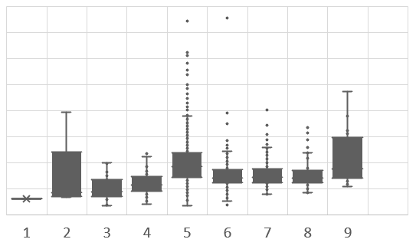
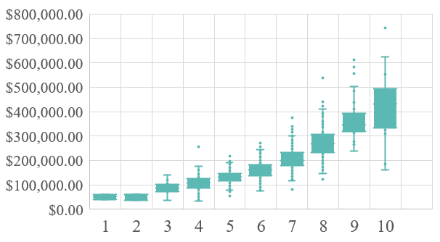
Comparison of Overall quality vs. Condition
Although Overall Quality is the top factor for predicting sale price, the same is not true for the Overall Condition of houses:
Overall Quality
Overall Condition (y-axis same scale)
Notes:
Overall condition of the home is another ordinal data type that rates the current condition of the home from 1 to 10, 1 being very poor, and 10 being very excellent. A home scoring 10 in overall condition would be expected to be nearly pristine. While lower scores indicate that the home has detracting conditions that may need to be addressed in the form of repairs or renovation. While this facet was not in the top 10 considerations as a driving factor of price, it should be considered by investors as an indicator that additional cost may be present.

Slide 10
Multi-car Garages
Correlation: 0.64
T-test: H₀: p = 0, H₁: P < .05
Houses with 3 car garage vs 4 car garage:
P = 0.005
P < .05 at .005
Notes:
Another factor that rated highly in my analysis was the inclusion of a 3 car garage, representative homes command nearly 3 times the average price of a home without a garage, this does not appear to be an additive effect as the average price sharply declines when looking at homes that have 4 car garages.

Slide 11
FirePlaces
For fireplaces, t-tests don’t show significant differences between with 2 and 3 fireplaces.
The results from the regression showed that the relationship between number of fireplaces and sale price had the 3rd highest coefficient.
Notes:
Number of fireplaces comes in at number three in factors that drive home prices. With little to no difference between 2 or 3 fireplaces.

Slide 12
Runner ups: also very significant
Year built and year remodeled are two details that are easy to glean and hold a lot of predictive value.
A sharp increase in sale price can be seen in both charts following the turn of the century.
Average Sale Price by year remodel added
Average Sale Price by year built
Notes:
On to our final two factors that drive home prices, Year Remodeled, and Year Built. My analysis shows they are closely tied to each other and to the sale price of the home. Both facets are good predictive indicators of a high sale price and are also closely related to overall quality and condition, where homes that were recently built or remodeled score significantly higher.

Slide 13
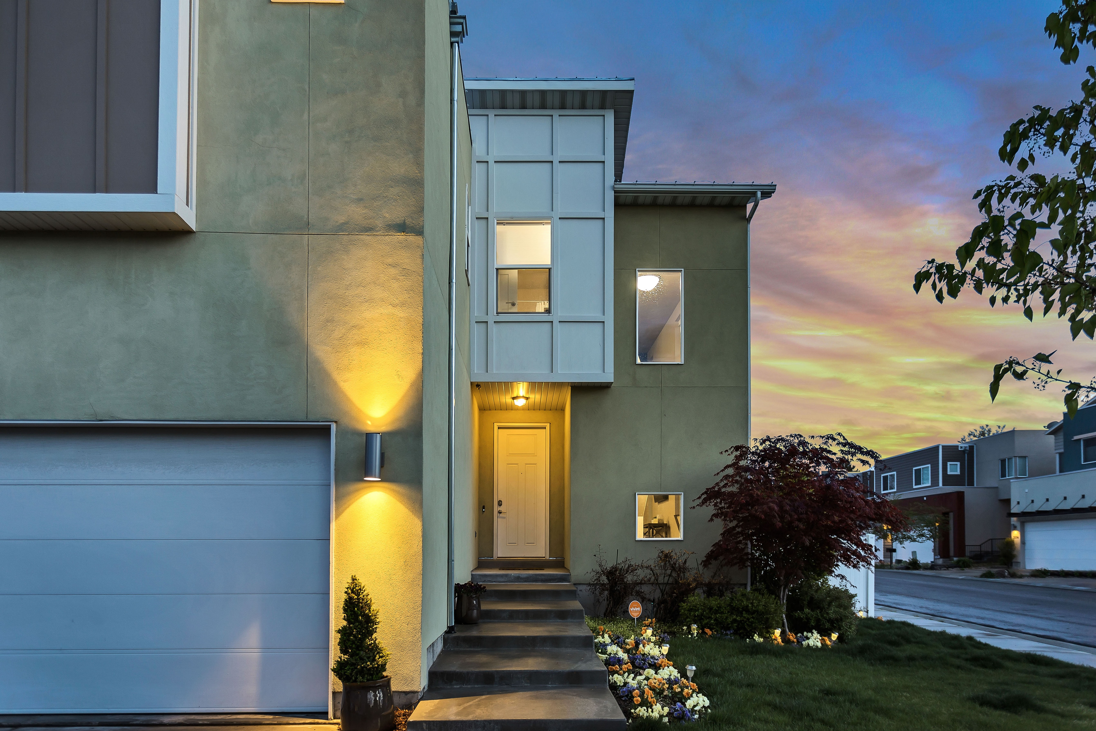
Conclusion
To bring it home, when making decisions for allocating the firm’s investment dollars, separate the signal from the noise by looking at the data on what factors drive home prices.
Recommendations:
When assessing a property for investment, take into account these factors, in order of significance from the regression:
1. Overall Quality
2. Garage Cars
3. Fireplaces
4. Year Remodel added
5. Year Built
6. Above Ground Living SF
7. Masonry Veneer SF
8. Total Basement SF
9. Kitchen Quality
10. Neighborhoods
Notes:
In conclusion, there are a huge number of factors involved in the sale of a home, most of which are simply not salient to the perspective of the investment potential of a property. By conducting this analysis using the scientific method and data analysis best practices to find the most influential factors in home sales we have narrowed the factors down to a very concise list that can be used to filter and rate prospective investment properties.

Slide 14



THANK YOU
mhcoxmail@gmail.com
www.maxinehcox.com
Notes:
Thank you for your time, this concludes my presentation. I hope my analysis has provided actionable insights for you to consider in your investment strategy and future endeavors.
Leave behinds and Deliverables available here: https://drive.google.com/drive/folders/1PUrd7vjubLjYMUOwE6DYgRQFoAXy0qMQ

